Slide 1

Cancer and how it relates to different aspects of daily life.
Cody Carpenter
Jake Rohbock
Johnny Ramirez
Samantha McKay

Slide 2



Agenda
Is there a correlation between income and cancer rates?
Do older populations have greater or lower poverty rates?
Does a higher percent of married households correlate with lower incidences of death as the outcome?
What percentage of cancer incidences result in death in each state on average?
What is the relationship between unemployment and cancer incidence for each state?
Does having private insurance vs public insurance correlate with higher or lower death percentages?

Slide 3

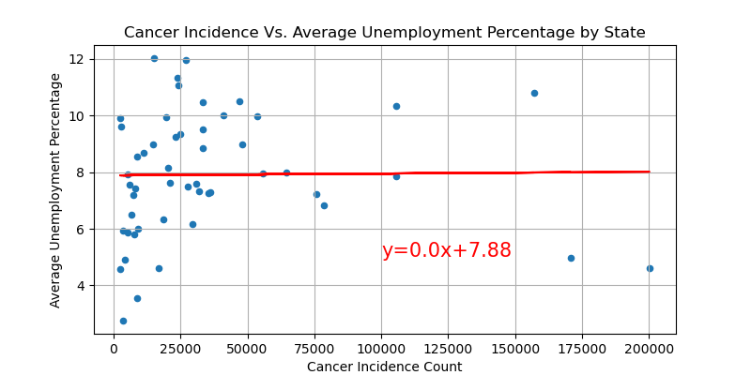
Unemployment and cancer incidence
Notes:
Strength= weak
form= nonlinear
direction=random, neither positive nor negative

Slide 4
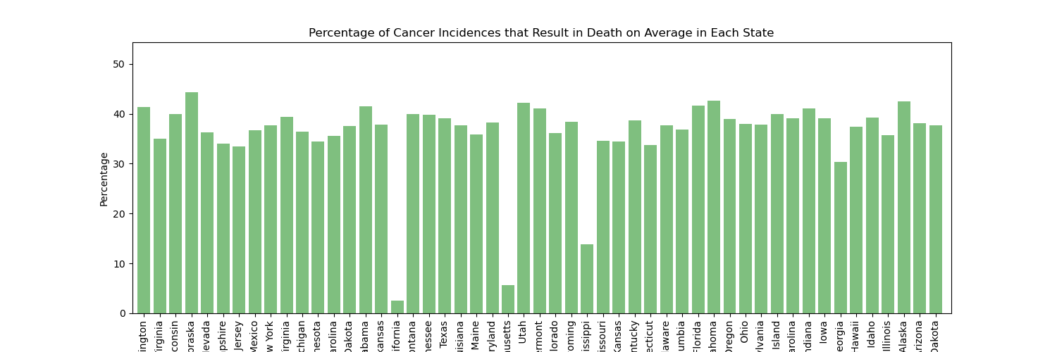
Percentage of cancer incidences resulting in death on average for each state
Notes:
Y axis is represented with percentage of people who were diagnosed with cancer who ended up dying.
X axis is represented by each state
Outliers were California, Massachusetts, and Mississippi.
Further studies would need to be conducted to understand why these 3 states reported such lower average death percentages from those that were diagnosed.

Slide 5
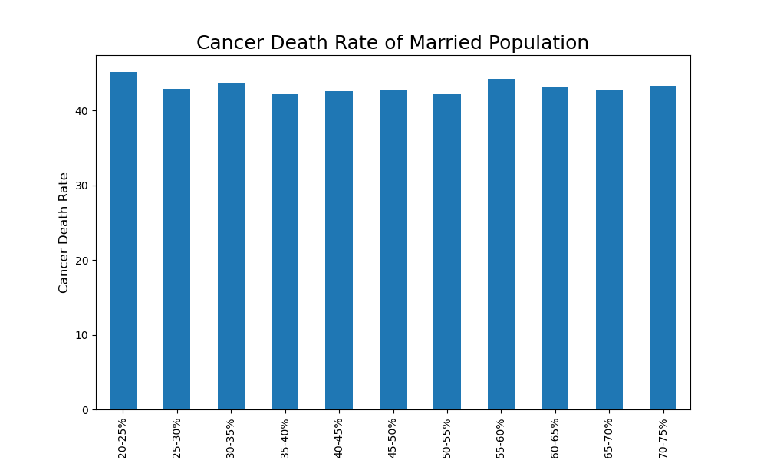
Marital Status and Cancer Outcomes
Notes:
Hypothesis: Higher marriage rates would lead to faster detection of cancer and less incidences of death from cancer.
Visually, there is no correlation between marital status and risk of dying from cancer.
Added age to see if areas with older people tend to have higher marriage rates.

Slide 6
Uninsured Death Rate Correlation
Notes:
Hypothesis: Higher marriage rates would lead to faster detection of cancer and less incidences of death from cancer.
Visually, there is no correlation between marital status and risk of dying from cancer.
Added age to see if areas with older people tend to have higher marriage rates.

Slide 7
Topic one
Subtitle

Slide 8
Topic one
Subtitle

Slide 9
Topic one
Subtitle

Slide 10

Summary

